Slide 1

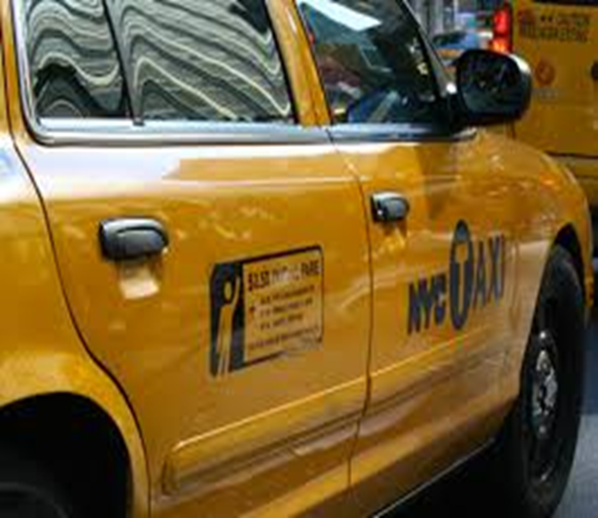
Prediction of Taxi Fare - New York City
Grishma Saparia - gsaparia@students.kennesaw.edu Anisha Kunduru- akunduru@students.kennesaw.edu Manogna Garlapati - mgarlap1@students.kennesaw.edu Varun Gottam - vgottam1@students.kennesaw.edu
Dinesh Kasanagottu- dkasanag@students.kennesaw.edu

Slide 2
Abstract
➢Taxis are used in New York City often more frequently than in any other city in the United States.
➢Approximately 200 million taxi rides are taken each year.
➢Humongous rides taken each month can provide changes in traffic patterns, road closures, and large-scale events that draw a large number of New Yorkers.

Slide 3
Research Statement and Conjecture
➢There are many methods used to predict the rate using real-time data. But using real-time data takes more resources and the predictions are very slow. ➢As Google introduced time estimates, computing fares became easy. So we want to use previous data (data collected from taxis) to estimate the fares rather than real-time data. This helps in giving faster prediction and accuracy nearer to the real-time data predictions.

Slide 4
Research Statement and Conjecture
➢ Uber, Lyft, and other ride-hailing companies allow users to plan their trips ahead of time, which city taxi drivers do not have.
➢ What if city taxi riders could schedule their taxi rides ahead of time?
Predicting fares helps people to plan ahead and take a taxi, spending optimal amount of money.

Slide 5
Related work
There have been many papers on predicting the route, tracking of busses using prior data.
In the research papers, the authors used real-time data for training purposes.
But we predict data using previous data, saving time and the predictions that we got are near to the predictions using real-time data.

Slide 6
Methodology
Predicting the taxi fare by analyzing previous trips.
Preprocessing the dataset to have attributes pickup and dropoff locations, trip distance, start time, number of passengers, and fare amount.
Applied feature engineering to improve the performance of machine learning models.
Prediction is done using KNN regression, Random forest, Adaptive boosting, and SVM.
A comparison of R2-scores is shown as the final result.

Slide 7
Data Set
Randomly picked 10,000 trips as a training dataset of 1.5 million taxi rides in the Kaggle dataset.
Training data set is further divided into two parts: 80 percent for training and 20 percent for testing.

Slide 8
Data set
Initial features of the dataset:
pickup_datetime - timestamp value indicating when the taxi ride started.
pickup_longitude - longitude coordinate of where the taxi ride started.
pickup_latitude - latitude coordinate of where the taxi ride started.
dropoff_longitude - longitude coordinate of where the taxi ride ended.
dropoff_latitude - latitude coordinate of where the taxi ride ended.
passenger_count - number of passengers in the taxi ride.
fare_amount - dollar amount of the cost of the taxi ride.

Slide 9
Data Preprocessing
Data Cleaning
Dropped data with which have negative fare amount as it doesn't seem to be realistic.
Dropped Missing data.
Passenger count which is greater than six and having zero passenger count for some of the taxi trips are dropped.
Pick and drop off coordinates out of new york city are removed.

Slide 10
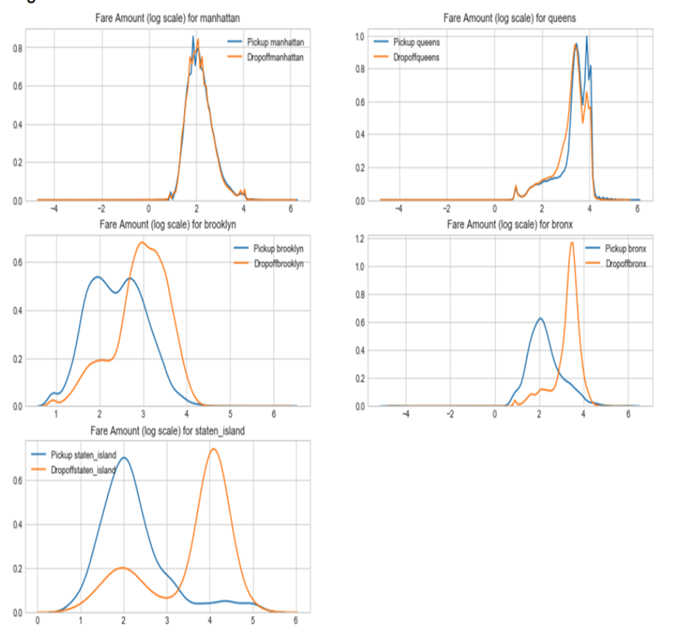
Feature Engineering
Converted the pickup_datetime attribute of type Object to different primitive types such as pickup_date,pickup_day,pickup_hour,pickup_day_of_week, pickup_month, pickup_year.
Calculated the haversine distance feature between the coordinates and padded as a distance feature.
Each pickup and drop off location was grouped through one of the five boroughs that make up New York City — Manhattan, Queens, Brooklyn, Staten Island, and the Bronx.

Slide 11
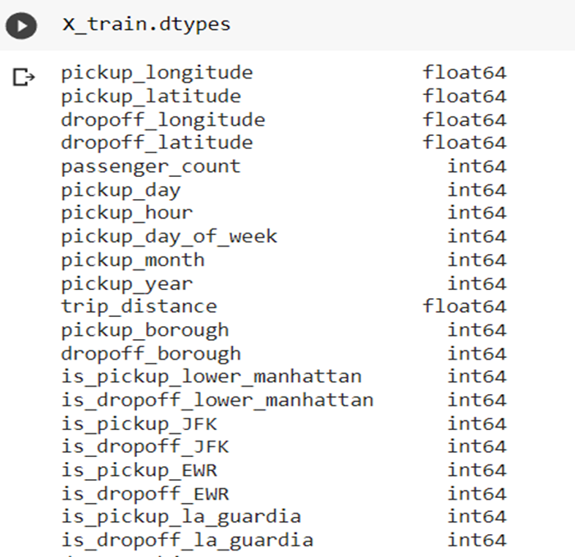
Feature Engineering
21 Factors used for models after feature engineering

Slide 12
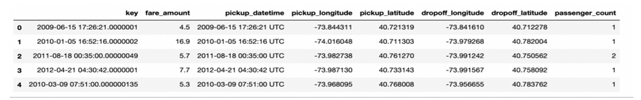
Data Before Feature Engineering

Slide 13
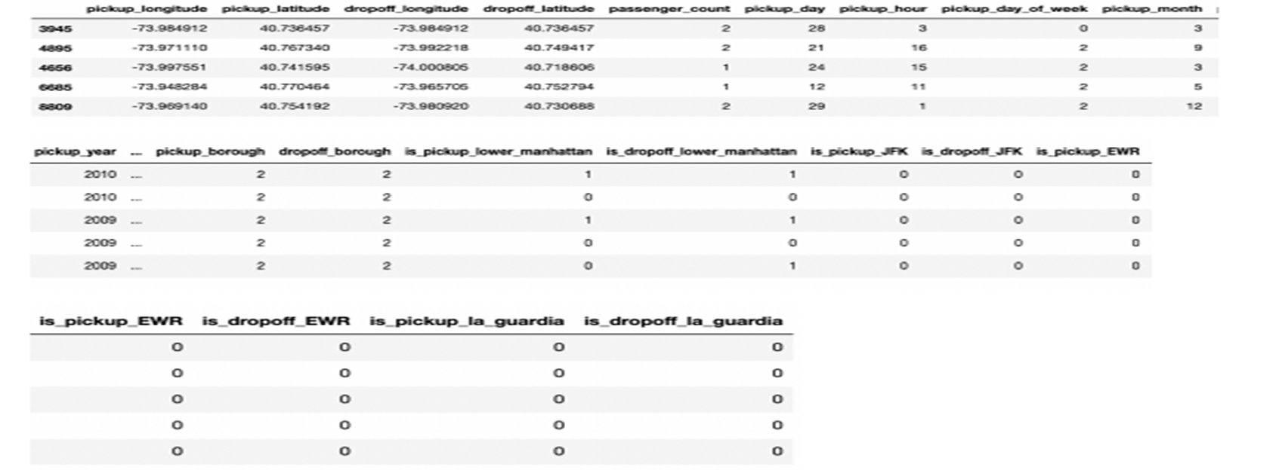
Data After Feature Engineering

Slide 14
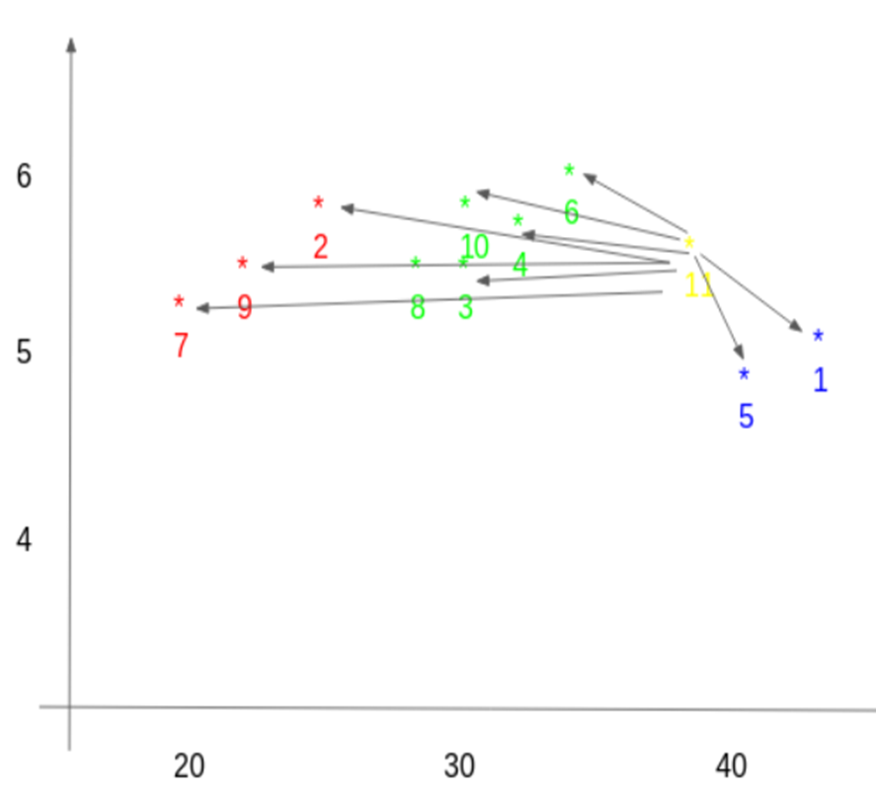
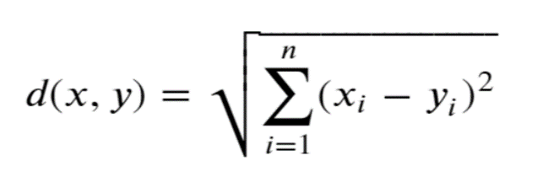
Knn Regression Model
KNN algorithm can be used for both classification and
regression problems.This algorithm uses
‘feature similarity’ to predict the values
of any new data points.
The concept of predicting the value of a new case is
based on the K closest values to the similarity
measure available. Finally ours being regression,
we choose mean of the values as final prediction.
a)Choosing similarity metric.(Euclidean distance)

Slide 15
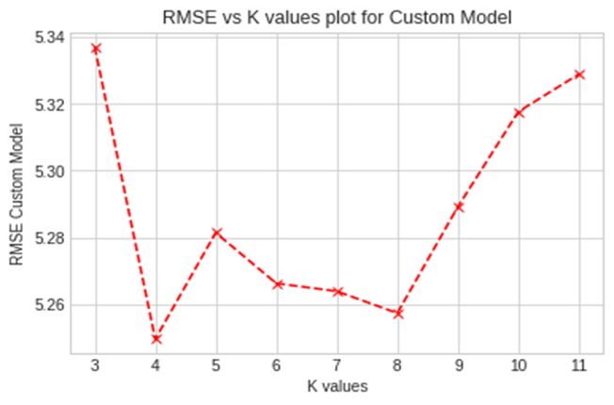
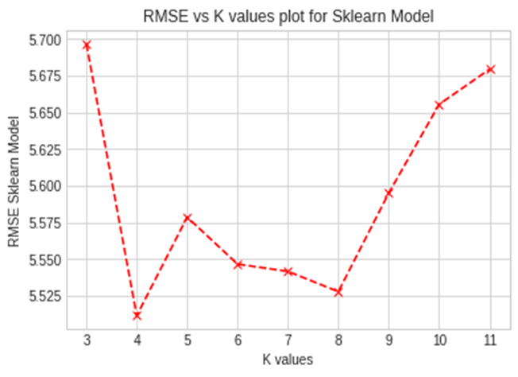
Knn Regression Model
b) Finding the optimal value of K
Plotted RMSE values for each value of k.
Observed best RMSE value between 4 to 8, and
choose K=4 for further validation.
c) Validation and prediction with sklearn
r2 metric score is used to examine the performance
of the model.
Running the model with k = 4
The r2_score of the custom model is 0.677757322
Running the sklearn model with k = 4
The r2_score of the sklearn model is 0.669399542

Slide 16
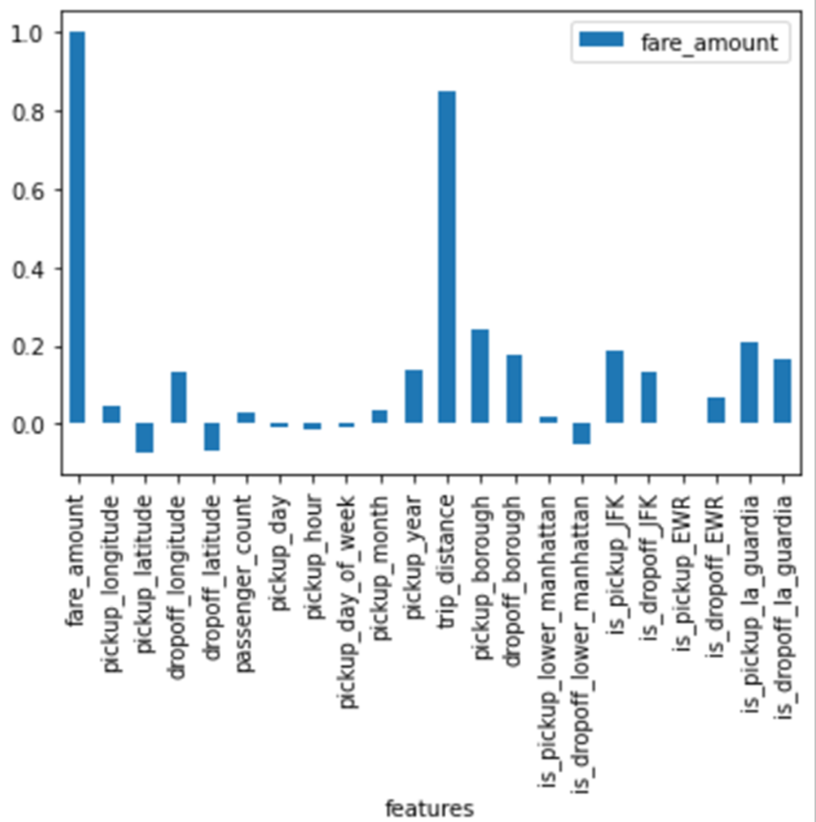
Random Forest Regressor
Feature Elimination using Spearman correlation
➢ Used Spearman correlation to eliminate a few features which have the least correlation with fare amount to reduce the curse of dimensionality.
➢ It evaluates the monotonic relationship between two continuous or ordinal variables. In a monotonic relationship, the variables tend to change together, but not necessarily at a constant rate.
➢This range lies between -1 to 1. So, eliminated 'is_pickup_EWR', 'pickup_day', 'pickup_day_of_week', 'pickup_month' columns as their values were close to 0.

Slide 17
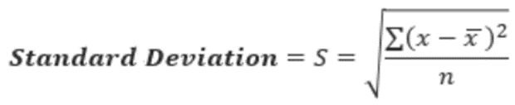
Decision Tree Regressor
➢ The data is partitioned into subsets that contain instances with similar values (homogenous) and a tree is built top-down from a root node.
➢ Decision trees can handle both categorical and numerical data.
➢ The leaf nodes represent a decision on the numerical target and the topmost decision node in a tree corresponds to the best predictor called the root node.
➢ We used standard deviation to calculate the homogeneity of a numerical sample.
➢ This process is run recursively until all data
is processed or stopping criteria[min_samples_split and max_depth ] are met

Slide 18
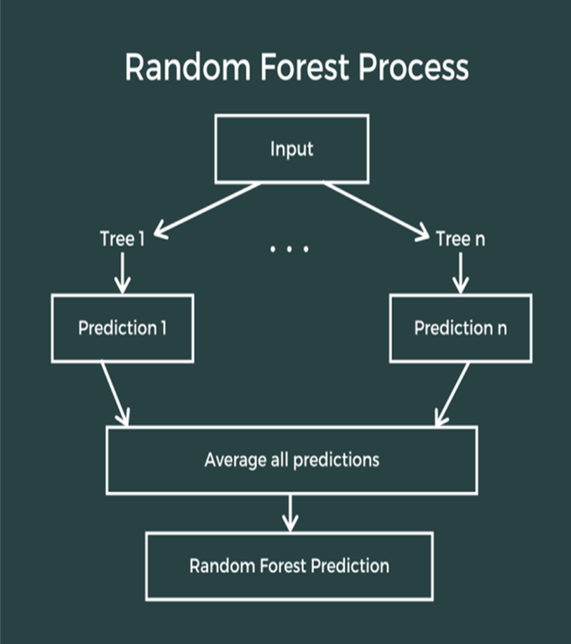
Random Forest Regressor
➢It is a supervised learning algorithm that uses ensemble learning technique for regression,i.e combines predictions from multiple machine learning algorithms to make a more accurate prediction than a single model.
➢Random Forest uses bagging for building decision trees.In bagging (also called bootstrap aggregating), multiple trees are created, and the final output is an average of all the different outputs predicted by multiple decision trees.
➢Bootstrap samples of data are taken and each sample trains a weak learner which helps to reduce the high variance which is usually seen in decision trees.

Slide 19
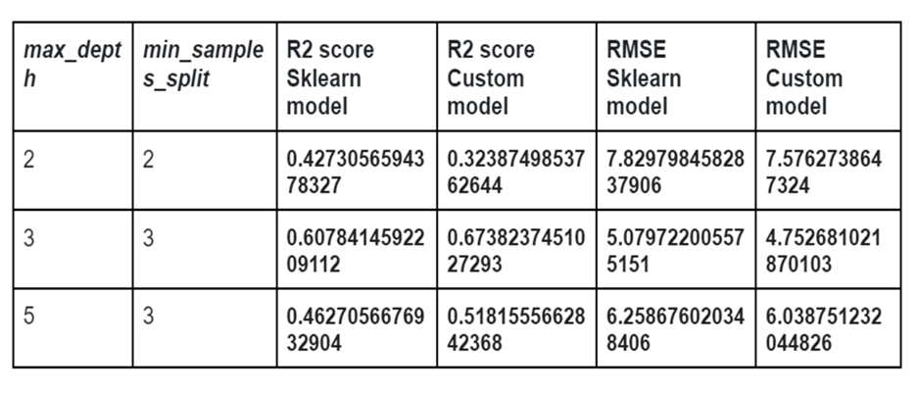
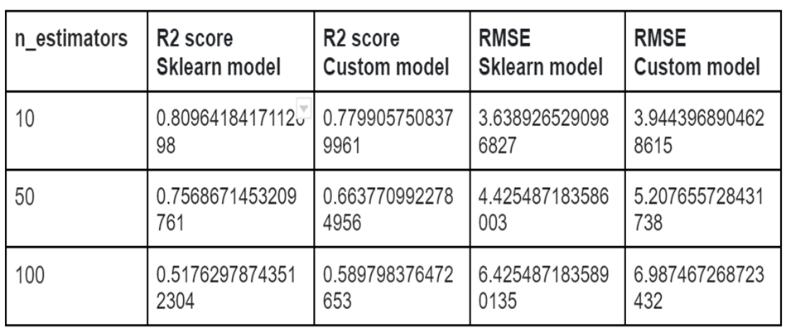
Evaluation of model
➢Used R2 score and RMSE to evaluate the model.
➢As observed, There was a significant difference and improvement in the prediction of the model after applying the ensemble bagging technique - Random forest over decision tree.
Decision Tree Result Random Forest Result

Slide 20
Adaboost
Using pearson coefficient for correlation between two variables, pickup_longitude, pickup_latitude, drop-off_longitude, drop-off_latitude, pickup_day, and passengaer_count are removed to increase the models performance.
This is an ensemble learning where weaker models are trained sequentially to make them stronger models for more accurate predictions.
Generally while using Adaboost, we use Decision Tree Regressor.

Slide 21
Adaboost
Algorithm:
Each row is given same weight, w = 1/N, where n is the number of datapoints.
We specify number of iterations for lower error rate.
Each iteration, it chooses model with lower error rate.
For each datapoint, if its misclassified, it will increase its weight so that it can be rectified in the next round.
The new weights are calculated are old_weight*e**(+/- alpha), where alpha is influence or importance that is ½(log(1-TE/TE)), TE-Total Error.
For wrong classification, we take alpha as +, and for right classification, we take alpha as -.

Slide 22
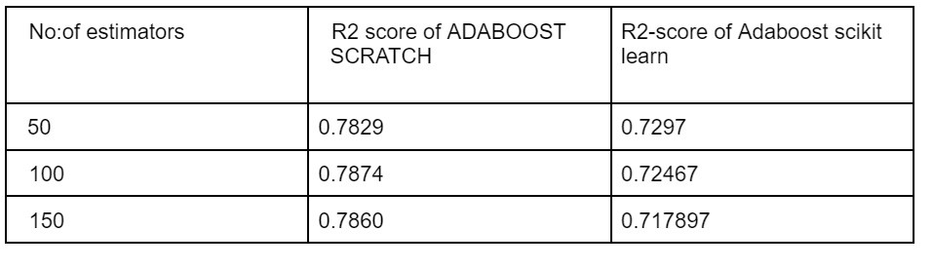
Adaboost
We take decision trees implemented from scratch and form scikit library.
Here number of estimators are number of weaker models in sequential order.

Slide 23
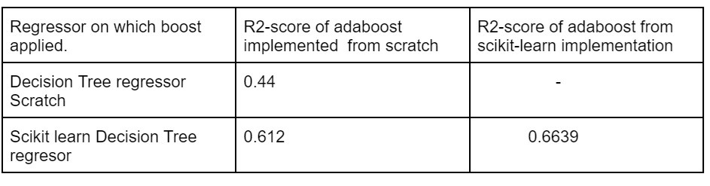
Adaboost
Scores of the decision trees after adaboost.
As we can see in the previous result, the R2 score did not increase much after 50 estimators.

Slide 24
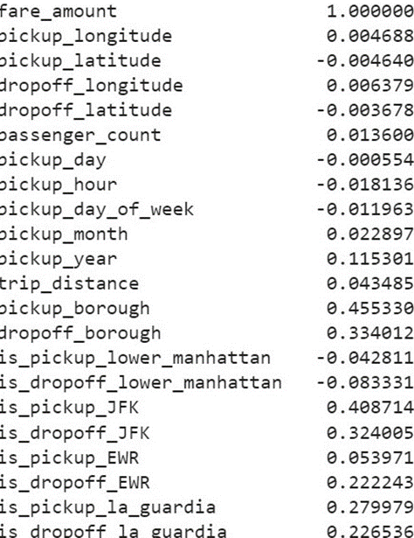
Support Vector Regression
Feature Elimination:
Because the Pearson correlation coefficient between 'taxi fare' and these features is not very significant, we deleted 'pickup EWR','passenger count','pickup day','pickup hour', and 'pickup month' from our list of features. Aside from those, we evaluated model using all of the remaining features. We can see the pearson coefficient values from the list attached.
We implemented linear support vector regression without any Kernel

Slide 25
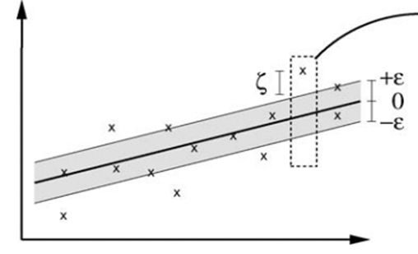
Linear Support Vector Regression
The points that satisfy the criterion |y_actual-(wx+b)|<=epsilon are those that are within the margin. The points that do not meet this criterion fall outside.
We don't penalize the points that fall within the margin. The gap between the margin and the data point is specified as the slack variable 'eta.' The width of the boundary is represented by the 2 epsilon value of the margin.
We utilized gradient descent to get the optimal values of 'w' and 'b' for linear support
vector regression. We estimated the y values for x test using these optimal w and b values. When the regularization constant 'C'=10, I received a r2 score of -0.22

Slide 26
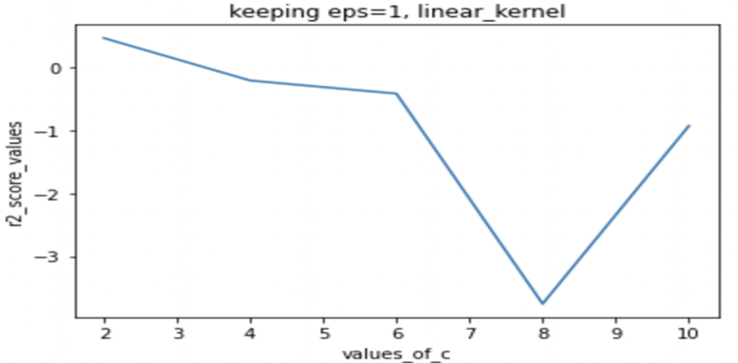
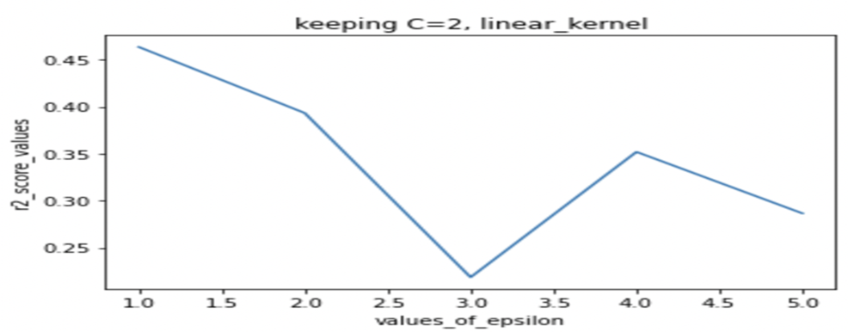
Linear Kernel
After performing linear svr without any kernels then we implemented svr with linear kernel using scikit-learn implementation. with scikit-learn implementation I got good r2_score=0.47 when C=2 but for some values of C we also got negative r2 score.
As a conclusion, we can deduce that even the linear kernel does not perform adequately. For many C values, my custom model outperformed the scikit-learn linear kernel implementation.

Slide 27
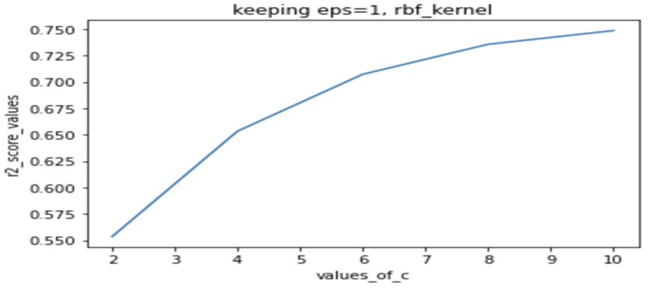
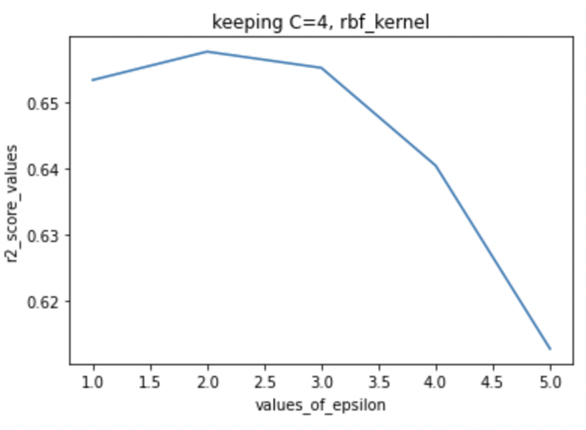
RBF Kernel
We implemented the rbf kernel using scikit learn. For the rbf kernel we fixed gamma value=’auto’ and then changed the remaining hyperparameters.
We can clearly see that for C=10 we are getting r2_score of value 0.75 which is the best score on this dataset.We can see that r2_scores are increasing when ‘C’ is increasing.
With ’epsilon=1’, we changed inverse regularization parameter C then calculated r2_score values.
When we fixed the ‘C’ value as 4 and changed the epsilon values.We can see that with increase of epsilon value the r2_score is slightly decreasing.

Slide 28
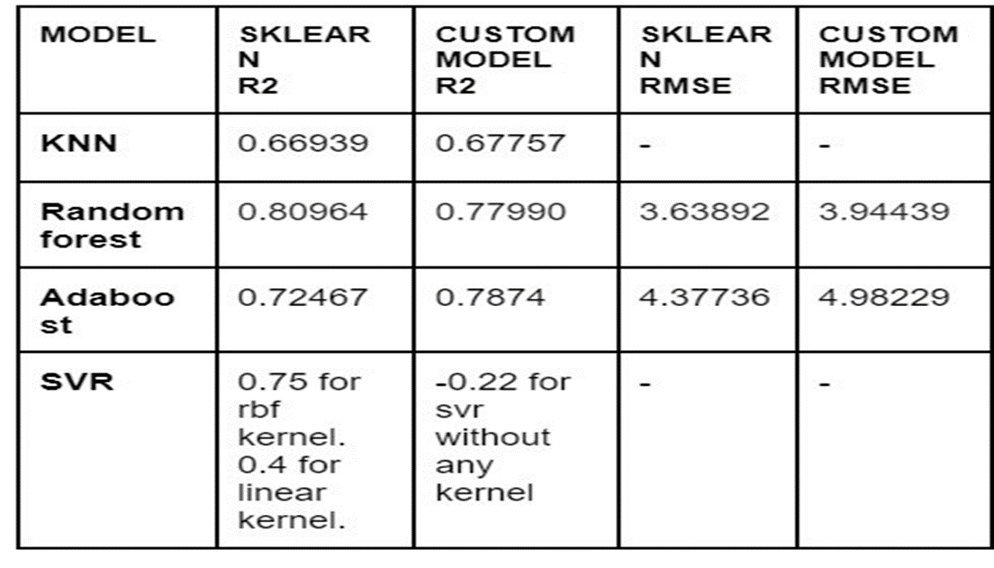
Experimental Evaluation
Rmse and r2-score of above implemented models shown below.

Slide 29
Experimental Evaluation
➢ Dimensionality reduction:
Apart from the feature engineering described above,we used the spearman coefficient and the pearson coefficient to compute the correlation between fare price and all other features,and we dropped a few features whose correlation values were very low in the adaptive boosting, random forest and SVR algorithms,respectively.As a result the models accuracy and performance improved noticeably.
➢ Accuracy:
In order to evaluate the models on test data we used R2_score and rmse to check the accuracy.In addition to that we also used Sklearn models to draw the comparison with the custom models built.As observed in the table below.

Slide 30
Conclusion And Future Work
It is observed that out of all the models Random Forest performed better when compared to other models with an R2-score of 0.779 and 0.8 accuracy of Sklearn model.
We got to the notion that the trip distance was the most essential factor in deciding the fare amount, While the number of passengers was the least important one. After Feature engineering, the R2_score decreased significantly
Future work:
We investigated few additional models such as LightGBM,neural networks and XGBM.We can improve the performance even further by using these models.

Slide 31
References
[1] Vanajakshi, L., S. C. Subramanian, and R. Sivanandan. "Travel time prediction under heterogeneous traffic conditions using global positioning system data from buses." IET intelligent transport systems 3.1 (2009): 1-9.
[2] Biagioni, James, et al. "Easytracker: automatic transit tracking, mapping, and arrival time prediction using smartphones." Proceedings of the 9th ACM Conference on Embedded Networked Sensor Systems. ACM, 2011.
[3] Yildirimoglu, Mehmet, and Nikolas Geroliminis. "Experienced travel time prediction for congested freeways." Transportation Research Part B: Methodological 53 (2013): 45-63.
[4] https://www.kaggle.com/c/new-york-city-fare-prediction.
[5] Wu, Chun-Hsin, Jan-Ming Ho, and Der-Tsai Lee." Travel-time prediction with support vector regression." IEEE transactions on intelligent transportation systems 5.4(2004): 276-281
[6] A Practical Introduction to K-Nearest Neighbors Algorithm for Regression (with Python code) - https://www.analyticsvidhya.com/blog/2018/08/k-nearest-neighbor-introduction-regression-python/
[7] https://scikit-learn.org/stable/modules/generated/sklearn.tree.DecisionTreeRegressor.html
[8] Understanding Adaboost-Understanding Ada Boosting... |by AkashDesarda | Towards Data Science
[9] https://scikit-learn.org/stable/modules/generated/sklearn.svm.SVR.html

